Slide 1

TECH 1004 & TECH 1004 UAC AI Technologies
Reinforcement Learning
By Hu Wang

Slide 2
Multi Armed Bandit

Slide 3
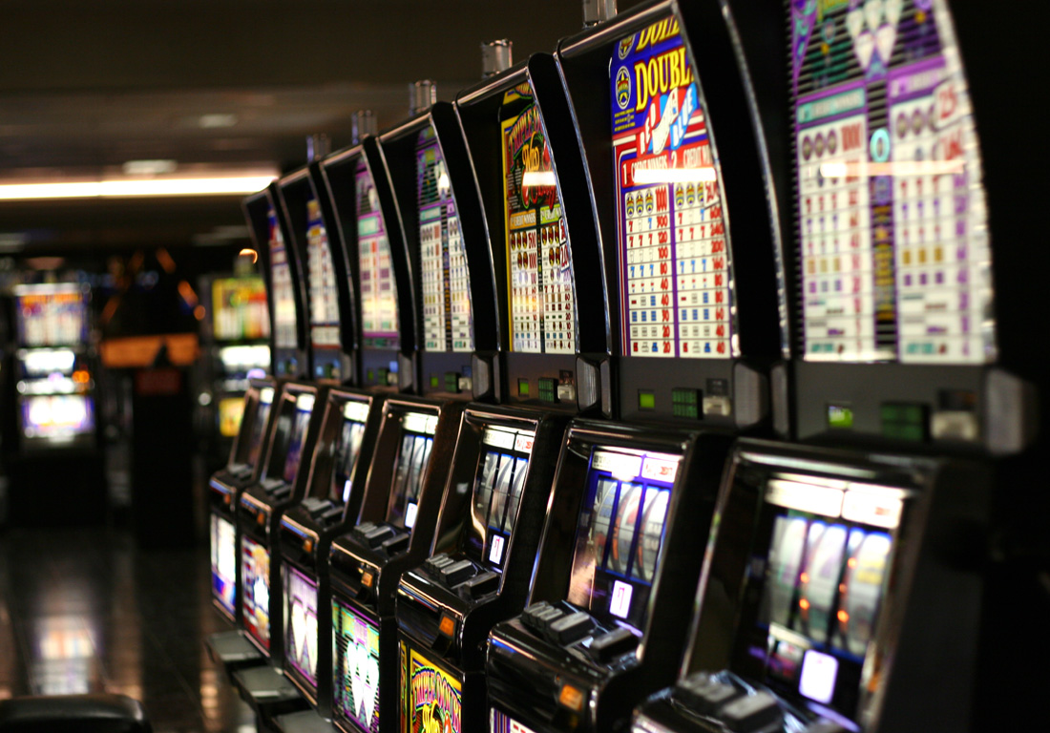
Multi Armed Bandit

Slide 4
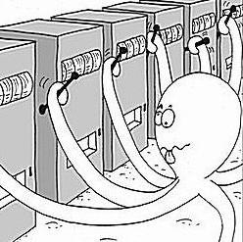
Multi Armed Bandit

Slide 5
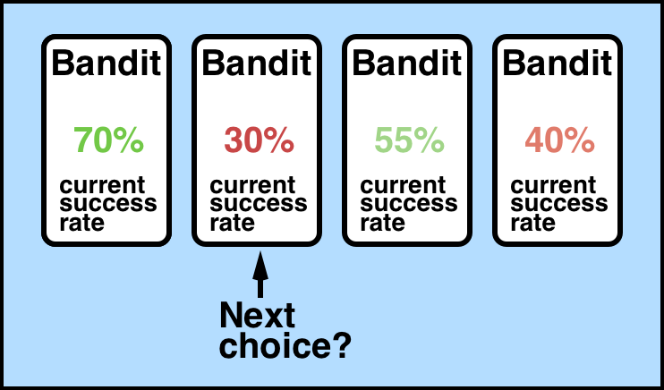
Multi Armed Bandit

Slide 6
Multi Armed Bandit --- Intuition
The Basic idea of Bandit algorithm:
Try carefully. If a certain choice yields a better result, choose it more; vice versa.
If a certain arm has been chosen too less, leading to uncertainty, give it more chances to be selected until it is determined to be gold or stone
In a word, give more opportunities to those arms which are "good enough" or "don’t know how good".

Slide 7
Warning of Programming

Slide 8
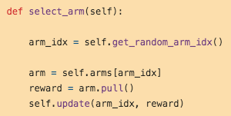
Multi Armed Bandit --- Random Select
Choose arms randomly

Slide 9
Demo

Slide 10
Multi Armed Bandit --- Naive
It is relatively simple. After each arm has been selected to calculate a mean, always choose the one with the largest mean.
Besides random, this algorithm is the easiest to implement in practice. Better than random agent.

Slide 11
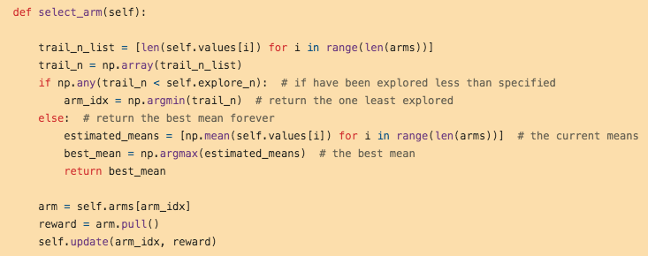
Multi Armed Bandit --- Naive

Slide 12
Demo

Slide 13
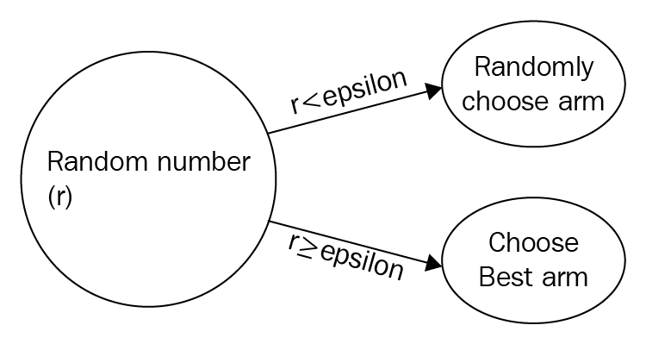
Multi Armed Bandit --- Epsilon-Greedy
Initially select a small positive number between (0, 1), as epsilon.
Each time randomly generate a number, if it smaller than epsilon, select an arm randomly; otherwise, the arm with the largest average value is selected.
The closer epsilon to 0, the more conservative; vice versa, the more radical.

Slide 14
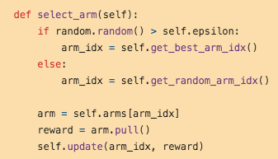
Multi Armed Bandit --- Epsilon-Greedy

Slide 15
Demo

Slide 16
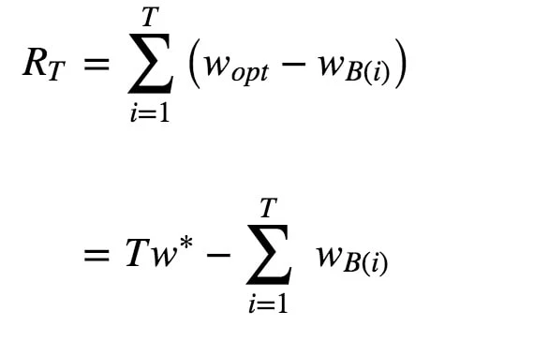
Multi Armed Bandit --- Evaluation

Slide 17
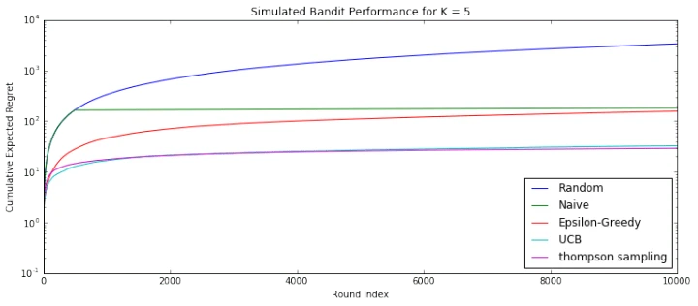
Multi Armed Bandit --- Comparison
Simulation performance of commonly seen MAB algorithms (10,000 times)

Slide 18
Reinforcement Learning

Slide 19
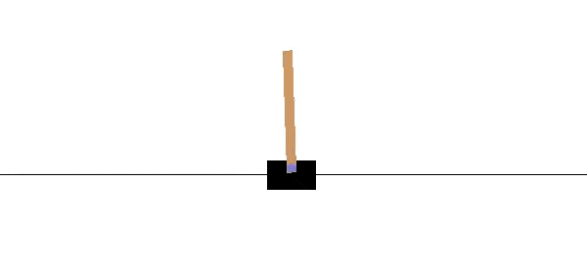
RL Environments --- openai gym
https://gym.openai.com/

Slide 20
Policy Gradient

Slide 21
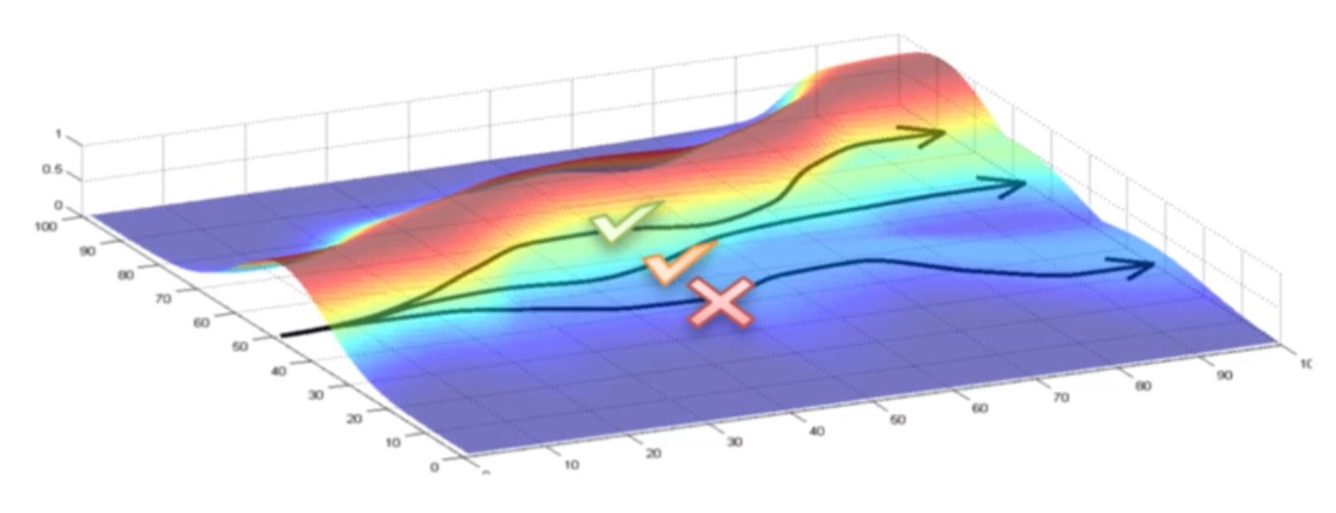
Policy Gradient --- Intuition

Slide 22
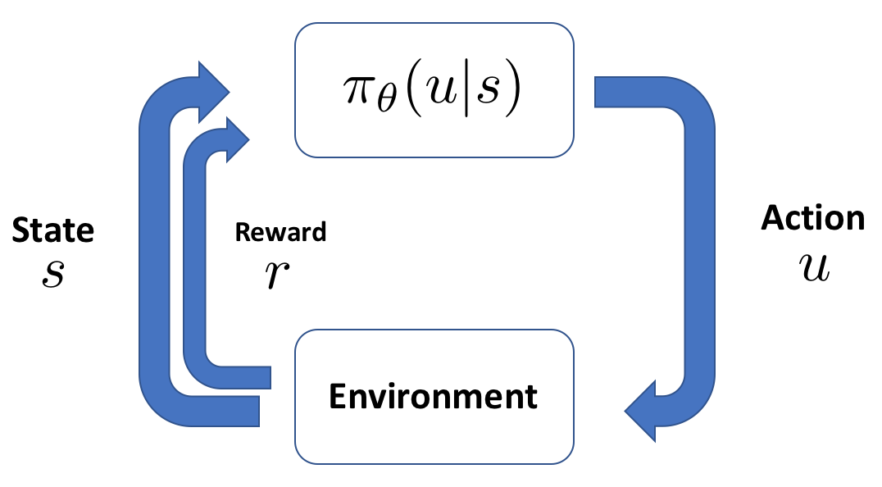
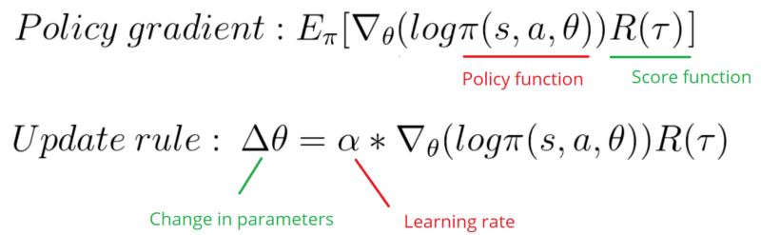
Policy Gradient --- Intuition

Slide 23
Warning of Programming

Slide 24
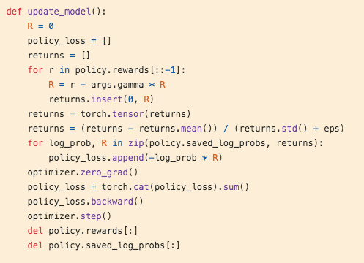
Multi Armed Bandit --- Random Select

Slide 25
Demo

Slide 26
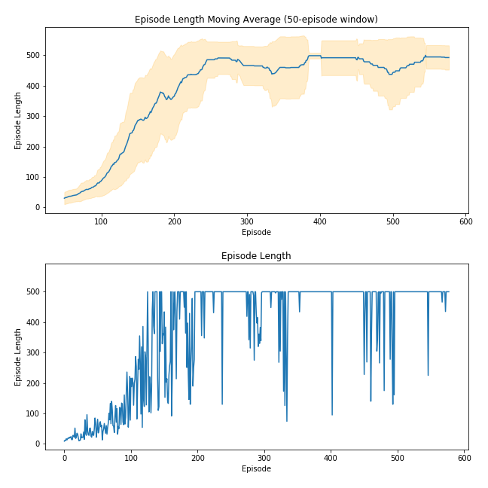
Policy Gradient --- Performance
https://medium.com/@ts1829/policy-gradient-reinforcement-learning-in-pytorch-df1383ea0baf

Slide 27
Q-Learning

Slide 28
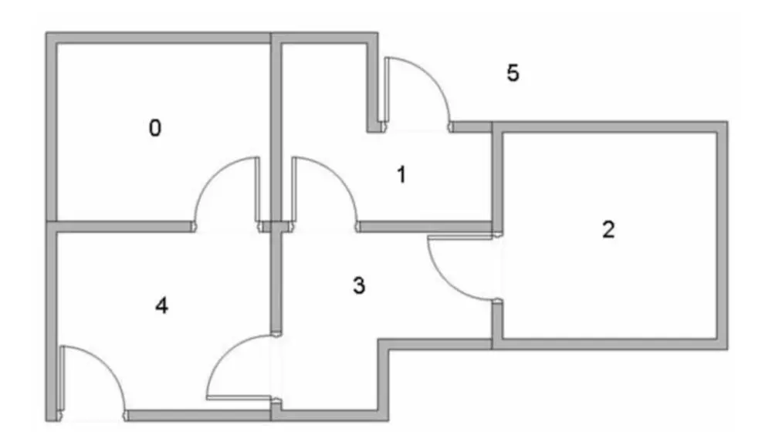
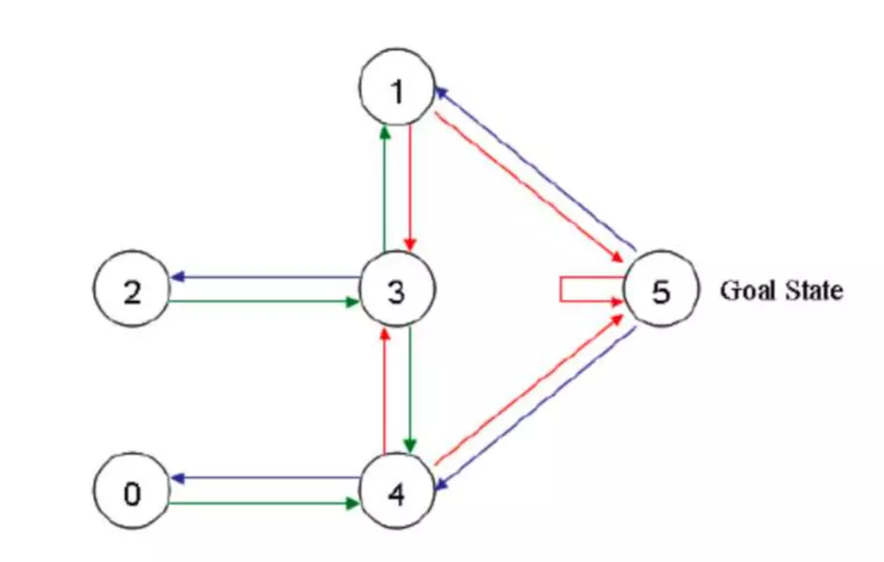
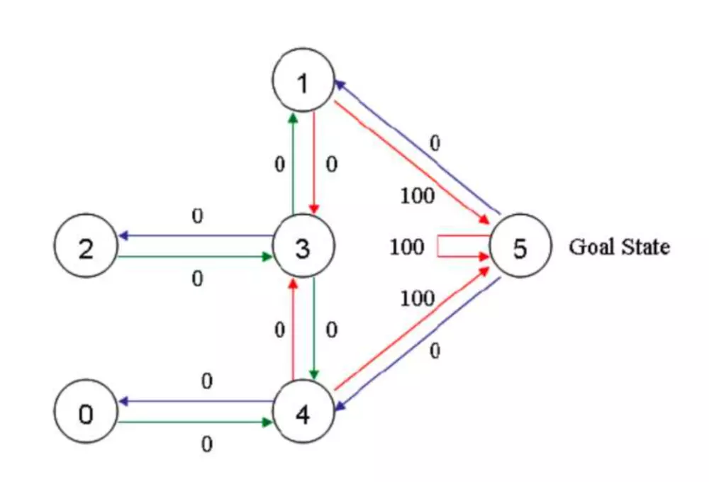
Q-Learning by hand
Q learning is based on the idea of Dynamic Programming (DP)
If the robots can get out of the house, then success; the reward (edge) to point 5 is set to 100, otherwise are set to 0
State: which room is the agent in
Action: which room to which room

Slide 29
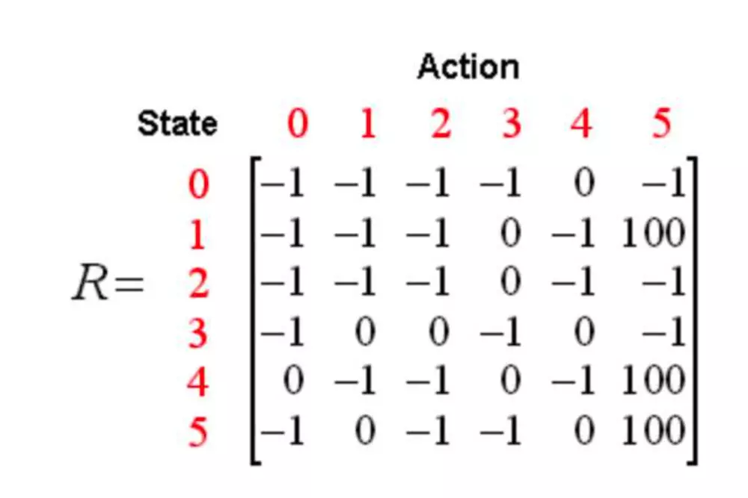
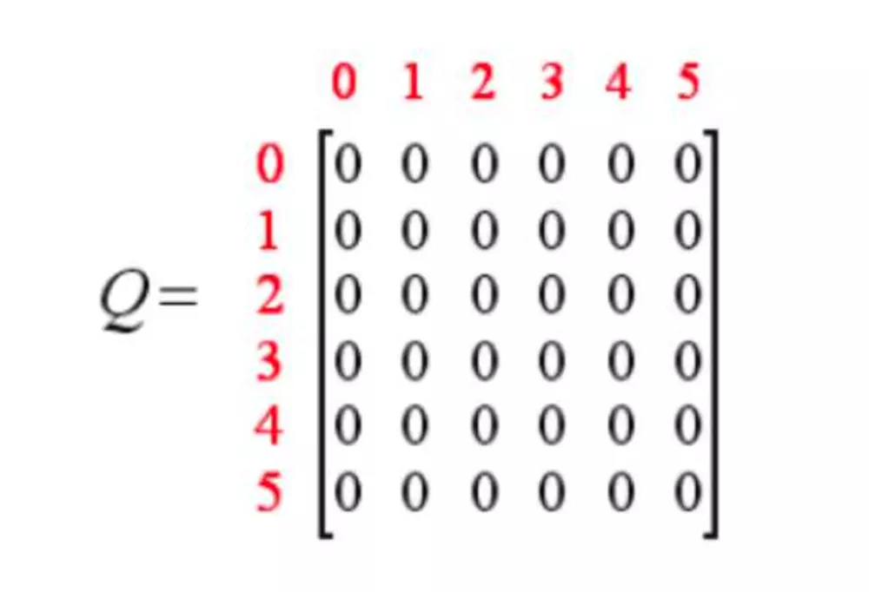
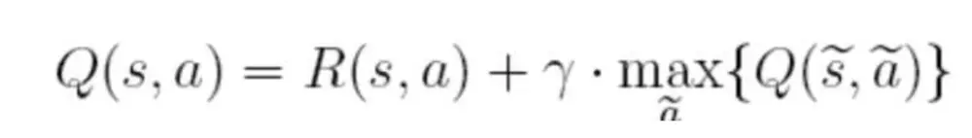
Q-Learning by hand
Instant reward matrix: 0 --- can pass through; -1 --- can not pass through; 100 --- success
Initial a Q table with the same rank of R matrix; all zero
γ = 0.8

Slide 30
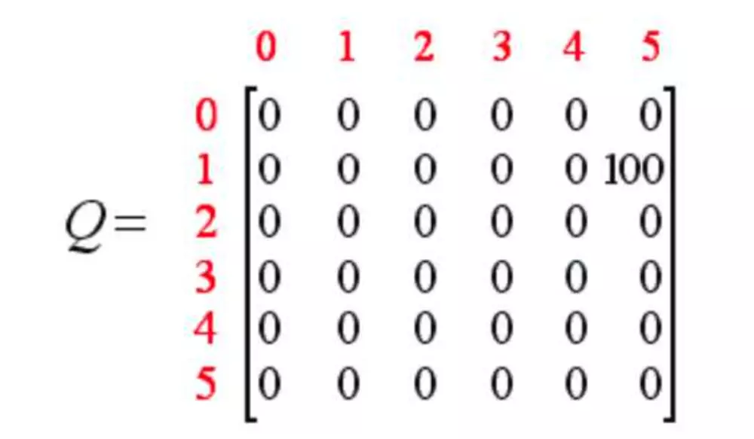
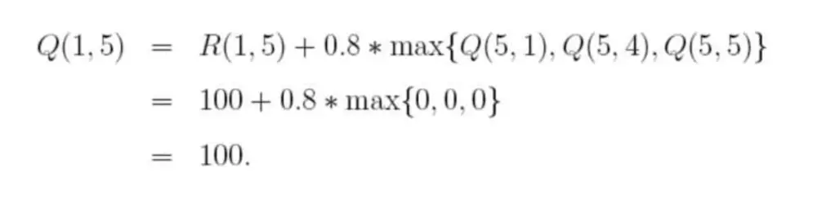
Q-Learning by hand
Randomly choose a state, for example room 1. The agent can reach room 3 or room 5. Randomly, if we choose 5, then we update the Q table

Slide 31
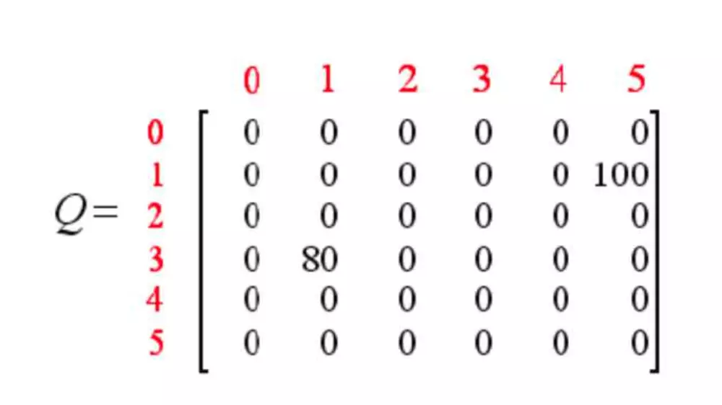
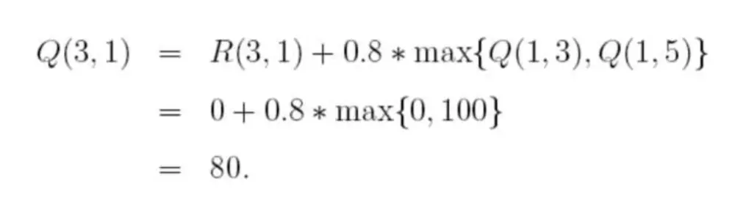
Q-Learning by hand
Then we choose a state randomly again, like room 3. Room 3 can go to room [1, 2, 4], and we random choose room 1

Slide 32
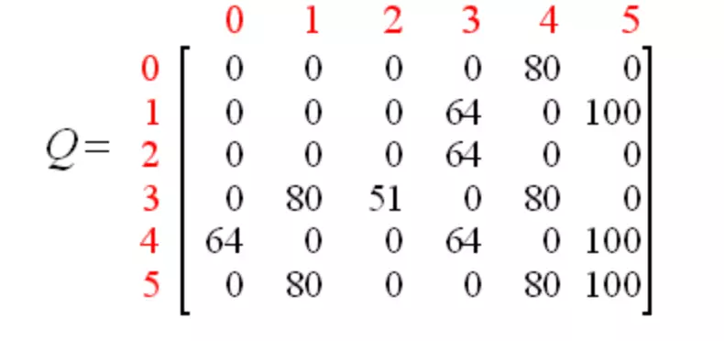
Q-Learning by hand
After many iterations, our final Q table is shown as above one
So we can choose our action based on our Q table

Slide 33
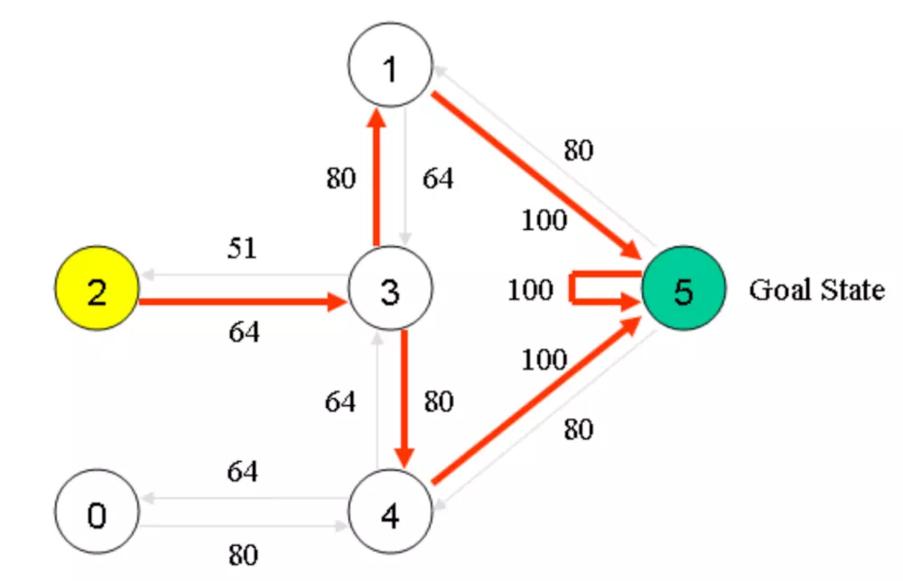
Q-Learning by hand
Q value means the expected accumulative reward of an action towards to the end

Slide 34
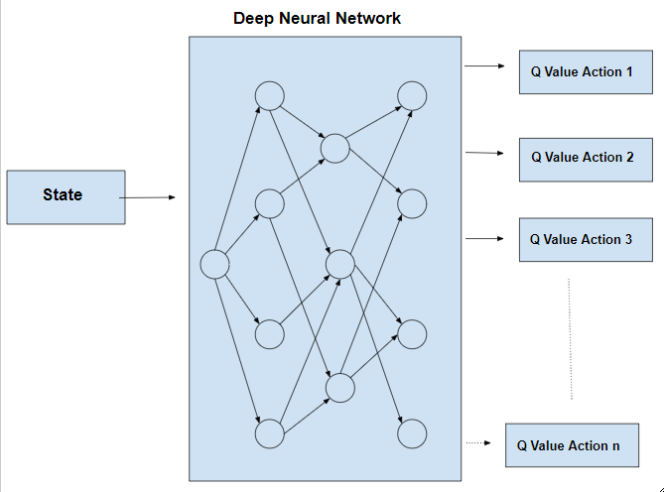
Q-Learning by hand
$$Q\left(s,a\right)=Q\left(s,a\right)+α[r+γmaxQ\left(s^{′},a^{′}\right)−Q\left(s,a\right)]$$

Slide 35
Demo

Slide 36
Reference
Mofan Tutorial, https://mofanpy.com/
David Silver, Reinforcement Learning Course, https://www.youtube.com/playlist?list=PLbWDNovNB5mqFBgq7i3MY6Ui4zudcvNFJ
Deep Reinforcement Learning, Decision Making, and Control - ICML 2017 Tutorial
https://www.youtube.com/watch?v=7Ys-yUvd1yk

